Slide 1
Real-World Reinforcement Learning The promise, Challenges and Opportunities
Enes Bilgin Sr. AI Engineer | Microsoft Autonomous Systems
April 21, 2021
Creighton university | heider college of business
github.com/ebilgin/talks

Slide 2
Background & Disclaimer
Sr. AI Engineer at Microsoft’s Autonomous Systems
Project Bonsai: A platform using Reinforcement Learning (RL) for the customers create autonomous systems for industry & business processes.
More at https://www.microsoft.com/en-us/ai/autonomous-systems
Disclaimer: This presentation solely reflects my own professional opinion of the topic, not Microsoft’s.

Slide 3


What is rl? Why rl? Why now?

Slide 4
What is reinforcement learning?
A subfield of machine learning (ML)
An AI agent learning how to make decisions in complex & uncertain environments
The goal is to maximize the long-term benefit (reward) of the agent
Sequential decision-making: Earlier decisions affect the outcomes later (e.g. like in chess)
The agent learns a policy (observation to action) through interaction of its environment

Slide 5
The amazing rise OF RL
Learn how to make near-optimal sequential decisions under uncertainty to maximize some long-term benefit.

Slide 6
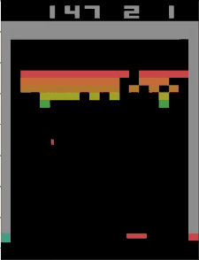
First breakthrough: ai learns playing Atari
In 2013, DeepMind published a study where an RL agent learned how to play Atari from raw screen pixels
A breakthrough following the deep learning revolution in computer vision

Slide 7
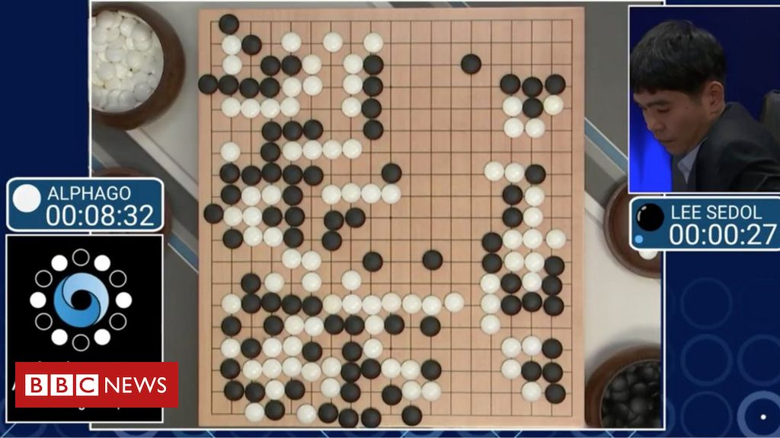
Second breakthrough: ai beats go champion
In 2016, DeepMind’s AlphaGo agent beats one of the best Go players, Lee Sedol
Go was considered a grand challenge for AI at the time

Slide 8
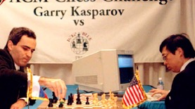
What is different?
AI agent learns how to accomplish the mission by itself through its interactions with the environment, with no human-coded strategies.
AI can go beyond what humans can imagine.

Slide 9
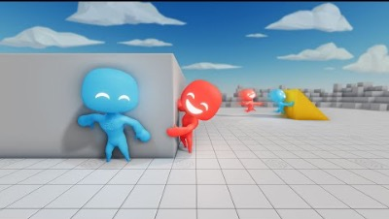
Emergence of intelligent behavior

Slide 10
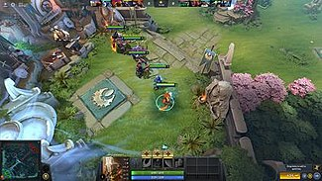



RL shines in much more complicated problems
DOTA 2
STARCRAFT II
ROBOT HAND
MuZERO

Slide 11
Why rl matters

Slide 12
The potential in rl to drive real-world value

Slide 13


RL LOOP
An intelligent agent:
Observes the environment
Takes an action
Aims to maximize long-term reward
RL is a decision-making framework, unlike supervised learning.
This is what life (and a business) is all about.
Action
Observation
Reward

Slide 14


Slide 15
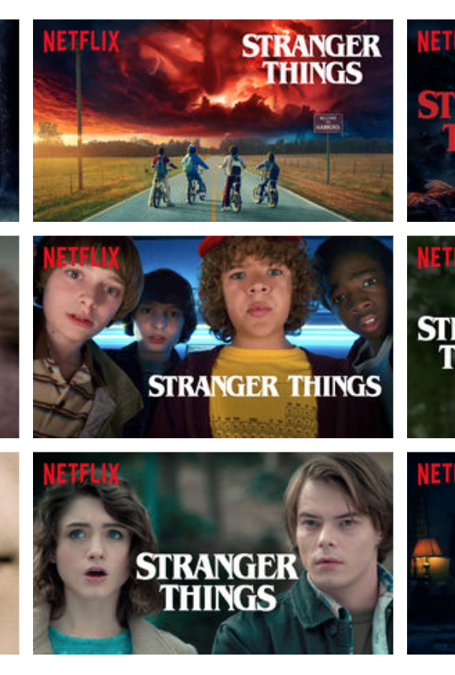
personalization
A title on Netflix has multiple artwork
RL-based algorithms learns which artwork to display based on
User interests
View context (time of the day, device etc.)
(Implicit) feedback on the previously displayed artwork

Slide 16
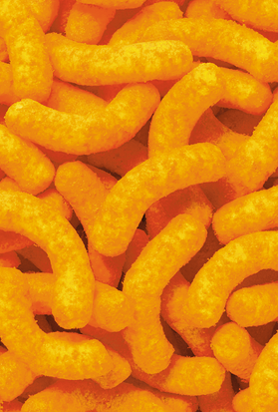
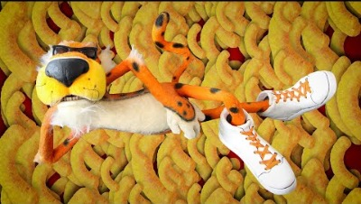
Manufacturing optimization
Microsoft and PepsiCo partnership to optimize the manufacturing process to produce the best Cheetos

Slide 17
Autonomous NAVIGATION
“Loon and Google AI achieved the world’s first deployment of reinforcement learning in a production aerospace system”

Slide 18
robotics
“Robot Taught Itself to Walk in a Simulation —Then Went for a Stroll in Berkeley”

Slide 19
Supply chain optimization
Many problems in supply chain can be tackled by RL
Inventory replenishment
Vehicle routing
Binning / packing

Slide 20
“This is great, let’s use RL everywhere!”
There are challenges to overcome…

Slide 21
CHALLENGE: SAMPLE EFFICIENCY

Slide 22
Challenge: sample efficiency
Algorithm comparisons on Atari
Resources to train a Dota 2 agent
The hunger for data in RL is much worse than that of deep supervised learning

Slide 23
CHALLENGE: NEED FOR SIMULATION

Slide 24
Need for Simulation
Among all processes in industry that can be automated via RL, an extremely tiny fraction of them have associated simulation models
When available, simulation models are often not suitable for RL:
Low fidelity – makes it hard to transfer trained models to real world.
Too slow – takes long time to collect enough samples.
Domain specific software – hard to integrate with RL libraries.
Constrained by licensing – very expensive to parallelize for experience collection.
No capabilities of revealing observations, resetting, domain randomization…

Slide 25
CHALLENGE: SIM-TO-REAL GAP

Slide 26
SIM-TO-REAL GAP
Agents trained in simulation tend to overfit to quircks of the simulation
Resulting policies can quickly fail in real world.

Slide 27
Solution approaches

Slide 28
How to overcome rl challenges
From ”Machine Learning” to “Machine Teaching”
Guide the training of the AI agent by infusing human expertise in a curriculum
Better integration with simulation tools
Emerging techniques such as domain randomization to close the sim2real gap
Directly learn from data: Offline RL
Simulation models are a rarity, but data / process logs are in abundance.
Offline RL learns directly from data produced by a non-RL controller
The policy does not interact with the environment during training.

Slide 29
conclusion

Slide 31
Thank you

Slide 32
therlbook.com

